Slide 1
CSP554 Big Data Technologies
Module 12
NoSQL Key/Value + Wide Column Store
Apache HBase (Hadoop)

Slide 2
HBase
Apache Hadoop has gained popularity for storing, managing and processing high volume and high velocity data
However, the Hadoop filesystem (HDFS) cannot handle random writes and reads and cannot change a file without rewriting it
HBase is a NoSQL, column oriented database built on top of Hadoop to overcome the drawbacks of HDFS as it allows fast random writes and reads in an optimized way
Also, with exponentially growing data, relational databases cannot handle the variety of data to render better performance
HBase provides scalability and partitioning for efficient storage and retrieval

Slide 3
HBase
HBase provides real-time read or write access to data in HDFS
HBase can be referred to as a data store instead of a database…
As it misses out on some important features of traditional RDBMs…
Like typed columns, triggers, an advanced (SQL) query language and secondary indexes

Slide 4
HBase Features
Strongly consistent reads/writes
HBase is not an "eventually consistent" data store
This makes it very suitable for tasks such as high-speed counter aggregation
Automatic sharding
HBase tables are distributed on the cluster via regions, and regions are automatically split and re-distributed as your data grows.
Automatic failover
Hadoop/HDFS Integration
HBase supports HDFS out of the box as its distributed file system.
MapReduce
HBase supports massively parallelized processing via MapReduce for using HBase as both source and sink

Slide 5
HBase Features
Java Client API: HBase supports an easy to use Java API for programmatic access.
Thrift/REST API: HBase also supports Thrift and REST for non-Java front-ends.

Slide 6
When to Consider HBase
HBase isn’t suitable for every problem.
First, make sure you have enough data
If you have hundreds of millions or billions of rows, then HBase is a good candidate
If you only have a few thousand/million rows, then using a traditional RDBMS might be a better choice…
Due to the fact that all of your data might wind up on a single node (or two) and the rest of the cluster may be sitting idle
Make sure you can live without all the extra features that an RDBMS provides
Such as typed columns, secondary indexes, transactions, advanced query languages, etc.

Slide 7
When to Consider HBase
An application built against an RDBMS cannot be "ported" to HBase by simply changing a JDBC driver, for example
Consider moving from an RDBMS to using HBase as a complete redesign as opposed to a port

Slide 8
HDFS vs. HBase
HDFS | HBase
Distributed file system | Built on top of HDFS
No fast data lookups | Fast data lookups via indexed files
Latency : high | Latency : low
Only sequential access | Random access via hash tables

Slide 9
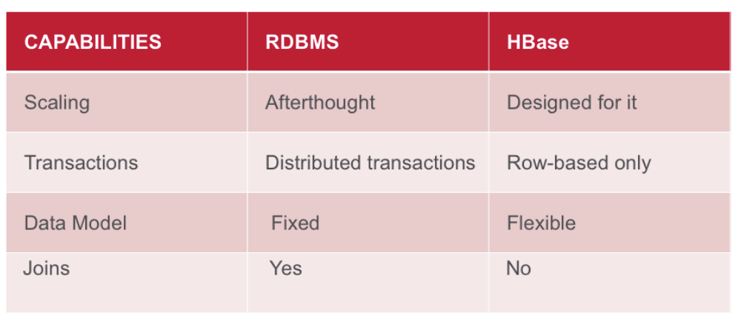
HBase vs. RDBMS Summary

Slide 10
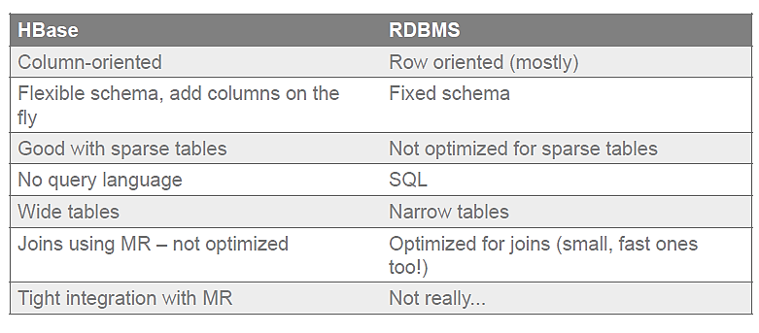
HBase vs. RDBMS Details

Slide 11
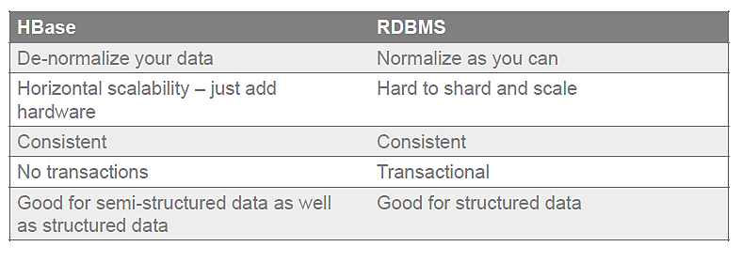
HBase vs. RDBMS Details

Slide 12
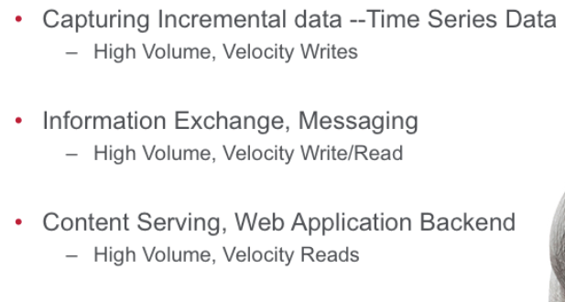
Main Use Case Categories

Slide 13
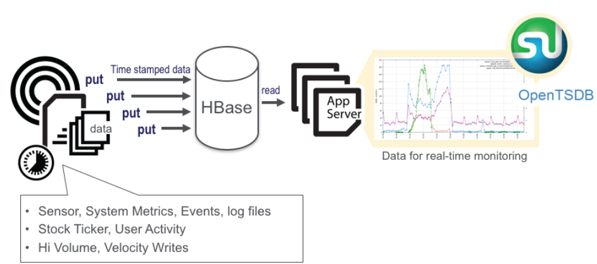
Time Series Data

Slide 14
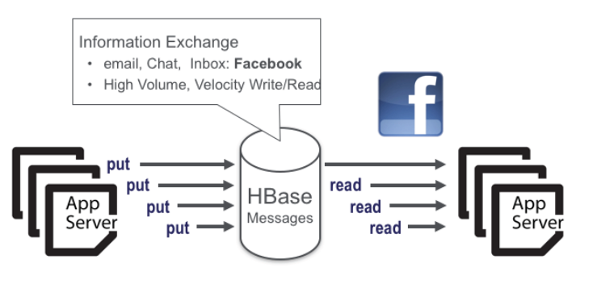
Information Exchange

Slide 15
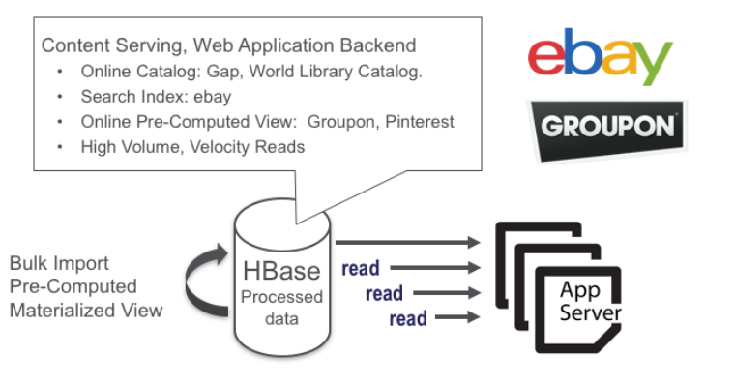
Content Serving

Slide 16
HBase Data Model
Applications store data in tables
Tables are made of rows and columns
Table cells—the intersection of row and column coordinates—are versioned
By default, their version is a timestamp auto-assigned by HBase at the time of cell insertion
A cell’s content is an uninterpreted array of bytes

Slide 17
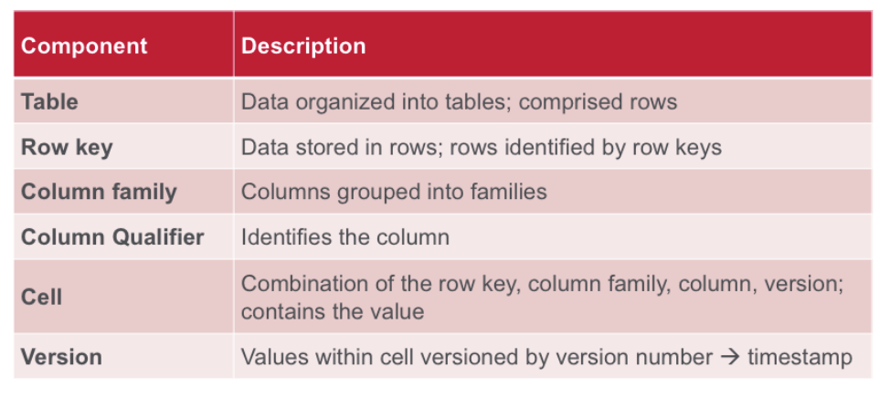
HBase Data Model Components

Slide 18
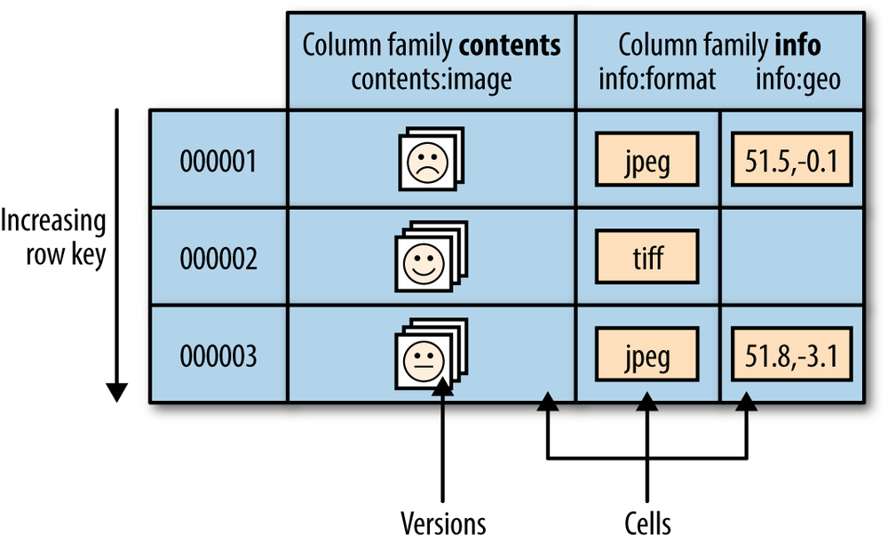
HBase Data Model

Slide 19
HBase Data Model
Table row keys are also byte arrays
So theoretically anything can serve as a row key, from strings to binary representations of long or even serialized data structures
Table rows are sorted by row key, aka the table’s primary key. The sort is byte-ordered
All table accesses are via the primary key, there are no secondary indexes
Row columns are grouped into column families
All column family members have a common prefix…
Columns info:format and info:geo are both members of the info column family…
While contents:image belongs to the contents family

Slide 20
HBase Data Model
A table’s column families must be specified up front as part of the table schema definition
But new column family members (new columns) can be added on demand
For example, a new column info:camera can be offered by a client as part of an update, and its value persisted
As long as the column family info already exists on the table
All column family members are stored together on the filesystem

Slide 21
HBase Data Model
HBase tables are like those in an RDBMS except…
Cells are versioned
Rows are sorted
Columns can be added on the fly by the client as long as the column family they belong to preexists

Slide 22
HBase Shell
$ hbase shell
hbase>
After you have started HBase, you can access the database interactively by using the HBase Shell

Slide 23
Using the HBase Shell
Names identifying tables and columns need to be quoted
There is no need to quote constants
Command parameters are separated using commas
To run a command after typing it in the shell hit enter key
Double quoting is required when you need to use binary keys or values in the shell
To separate keys and values you use the => character
To specify a key you use predefined constants like NAME, VERSIONS and COMPRESSIONS

Slide 24
Using the HBase Shell
To get help and see all commands, use the help command
To get help on a specific command, use help "command”
hbase> help "create"

Slide 25
Create a Table
In its simplest form the create command is used to create a table by specifying the table name and column family
To reduce disk space used for storing data it is advisable to use short column family names.
This is because storage of each value happens in a fully qualified manner
Frequent change of column names and use of many column families is not good practice
A compromise design is to have a few column families then you can have many columns in each family.
The format of naming columns is to specify the column family then the column name (family:qualifier).

Slide 26
Create a Table
A basic command that creates a table with two column families is shown below
CREATE ‘courses’ ‘hadoop’ ‘programming’
To add columns in each column family the command is enhanced as shown below
CREATE ‘courses’ ‘hadoop:spark’, ‘programming:java’

Slide 27
Create a Table
HBase allows you to have multiple versions of a row
This arises because data changes are not applied in place, instead a change results in a new version
To control how this happens you specify the number of versions or time to live (TTL)
When any of these settings are exceeded rows are removed when data compaction is done
CREATE t1, ’f1’, {NAME => ’f2’, VERSIONS => 3}

Slide 28
Put Data into a Table
If you’re using HBase, then you likely have data sets that are TBs in size
As a result, you’ll never actually insert data manually
However, knowing how to insert data manually could prove useful at times
Put a cell ‘value’ at specified table/row/column:
PUT 'cars', 'row1', 'vi:make', 'bmw'

Slide 29
Get Data From a Table
The get command allows you to get one row of data at a time
You can optionally limit the number of columns returned
We’ll start by getting all columns in row1
GET 'cars', 'row1’
To get one specific column include the COLUMN option.
GET 'cars', 'row1', {COLUMN => 'vi:model'}
You can also get two or more columns by passing an array of columns.
GET 'cars', 'row1', {COLUMN => ['vi:model', 'vi:year']}

Slide 30
Scan Data From a Table
Selectively query the contents of a table
Pass table name and optionally a dictionary of scanner specifications
Scanner specifications may include one or more of:
TIMERANGE, FILTER, LIMIT, STARTROW, STOPROW, TIMESTAMP, MAXLENGTH, COLUMNS, CACHE
If no columns are specified, all columns will be scanned
To scan all members of a column family, leave the qualifier empty as in ‘col_family:’

Slide 31
Scan Data From a Table
We’ll start with a basic scan that returns all columns in the cars table.
SCAN 'cars’
The next scan we’ll run will limit our results to the make column qualifier.
SCAN 'cars', {COLUMNS => ['vi:make']}
If you have a particularly large result set, you can limit the number of rows returned with the LIMIT option
SCAN 'cars', {COLUMNS => ['vi:make'], LIMIT => 4}

Slide 32
HBase Scalability
Tables are automatically partitioned horizontally by HBase into regions
Each region comprises a subset of a table’s rows
A region is denoted by the table it belongs to, its first row (inclusive), and its last row (exclusive)
Initially, a table comprises a single region, but as the region grows it eventually crosses a configurable size threshold…
At which point it splits at a row boundary into two new regions of approximately equal size
Until this first split happens, all loading will be against the single server hosting the original region

Slide 33
HBase Scability
As the table grows, the number of its regions grows
Regions are the units that get distributed over an HBase cluster
In this way, a table that is too big for any one server can be carried by a cluster of servers, with each node hosting a subset of the table’s total regions
This is also the means by which the loading on a table gets distributed
The online set of sorted regions comprises the table’s total content.

Slide 34
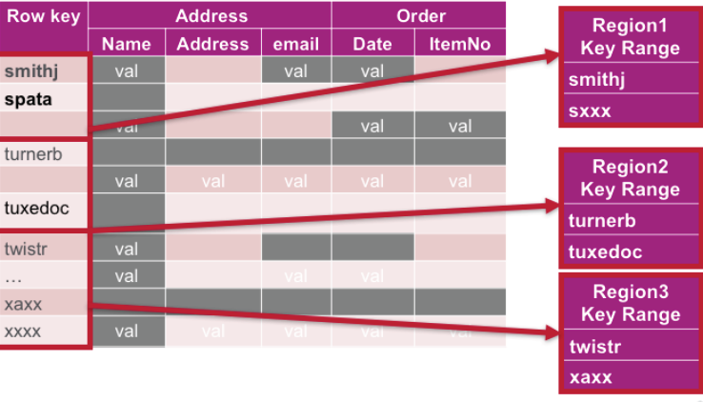
HBase Scalability
A continuous, sorted set of rows that are stored together is referred to as a region (subset of table data)

Slide 35
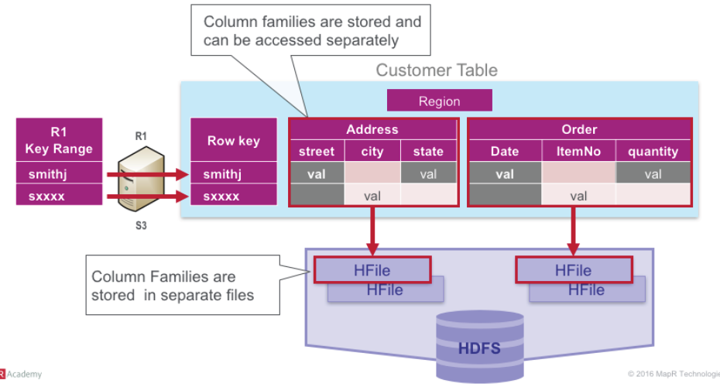
HBase Scalability

Slide 36
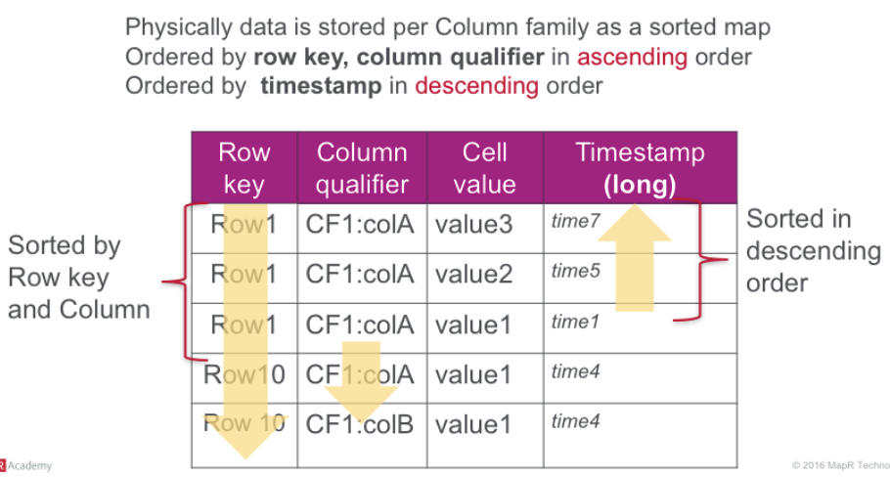
HFile Physical View

Slide 37
HBase Scalability
So this is why HBase is described as a column store
Each region holds an ordered subset of a table’s rows
Within a region each column family is stored separately (in an HFile)
So queries on just one column family of a table result in faster lookups and also the need to scan less data
Queries that span regions can be parallelized to the extent that regions are stored across multiple nodes (region servers)
Tables can grow to terabytes and more while no region will grow to beyond a configured maximum size before automatic resharding occurs

Slide 38
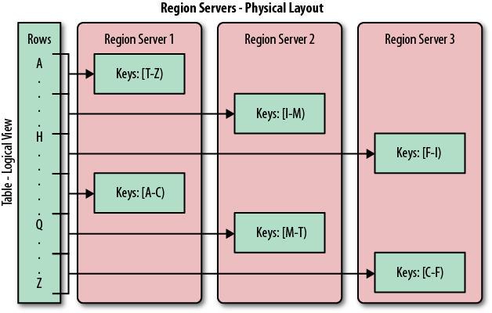
HBase Scalability

Slide 39
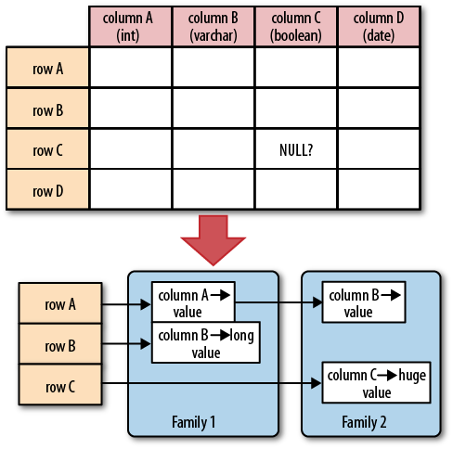
Sparse Table Storage
For a database with a fixed schema, you have to store NULLs where there is no value
But for HBase you simply omit the whole column…
In other words, NULLs do not occupy any storage space

Slide 40
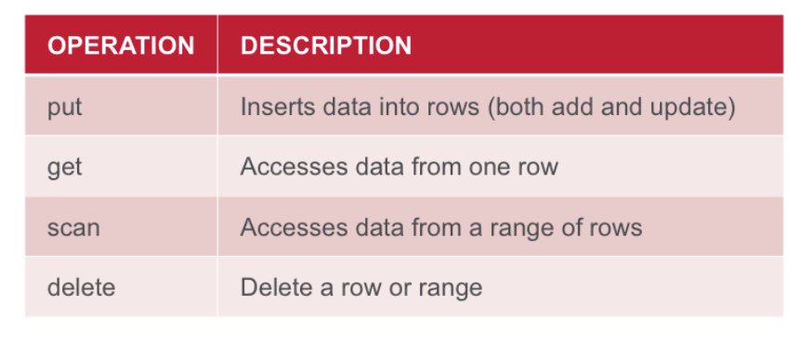
Basic Data Access Operations

Slide 41
ACID Properties
HBase is not ACID-compliant, but does guarantee certain specific properties…
All changes are atomic within a row
Any put will either wholly succeed or wholly fail
But API calls that change several rows will not be atomic across the multiple rows
All rows returned via any access API will consist of a complete (consistent) row that existed at some point in the table's history

Slide 42
Apache Phoxnix
Apache Phoenix takes your SQL query, compiles it into a series of HBase scans to produce JDBC result sets
Use of the HBase API, along with coprocessors and custom filters, results in performance on the order of milliseconds for small queries, or seconds for tens of millions of rows.

Slide 43
Apache Phoenix
A SQL Extension for Hbase
Provides a SQL interface for managing data in Hbase.
Large subset of SQL:1999 mandatory feature set.
Create tables, insert and update data and perform low-latency point lookups through JDBC.
Phoenix JDBC driver easily embeddable in any app that supports JDBC.
Phoenix Makes HBase Better
Oriented toward online / semi-transactional apps
Performance on the order of milliseconds for small queries, or seconds for tens of millions of rows.

Slide 44

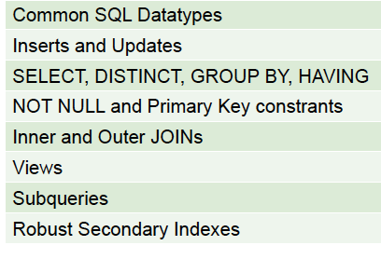
Apache Phoenix: Current Capabilities
Features

Slide 45
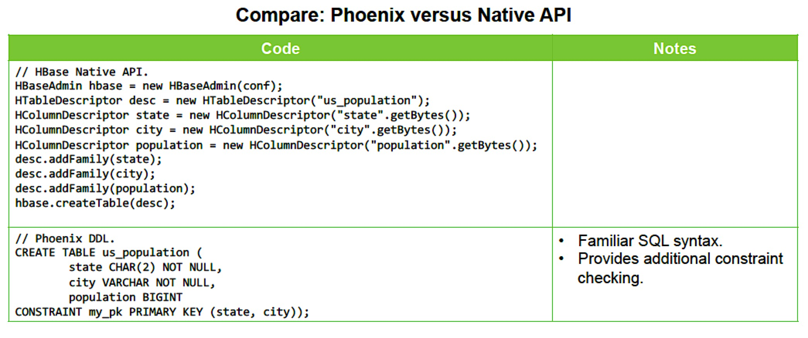
Phoenix Provides Familiar SQL Constructs

Slide 46
Phoenix Performance
Phoenix Performance Characterization:
Suitable for 10s of thousands of point-lookups per second
Suitable for thousands of aggregations / filtered searches per second
Supports extremely high concurrency.
Performance characteristics:
Index point lookups in milliseconds
Aggregation and Top-N queries in a few seconds over large datasets.

Slide 47
HBase Architecture
HBase made up of an HBase master node orchestrating a cluster of one or more regionserver workers
The HBase master is responsible for assigning regions to registered regionservers, and for recovering regionserver failures
The regionservers carry zero or more regions and handle client read/write requests
They also manage region splits, informing the HBase master about the new regions

Slide 48
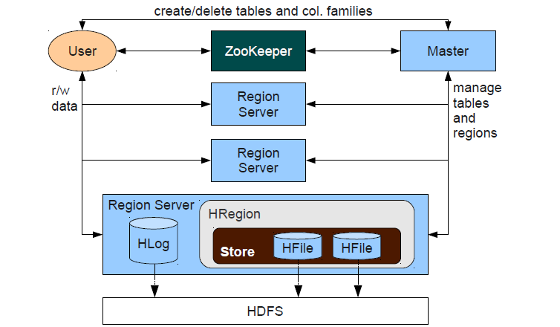
HBase Logical Architecture

Slide 49
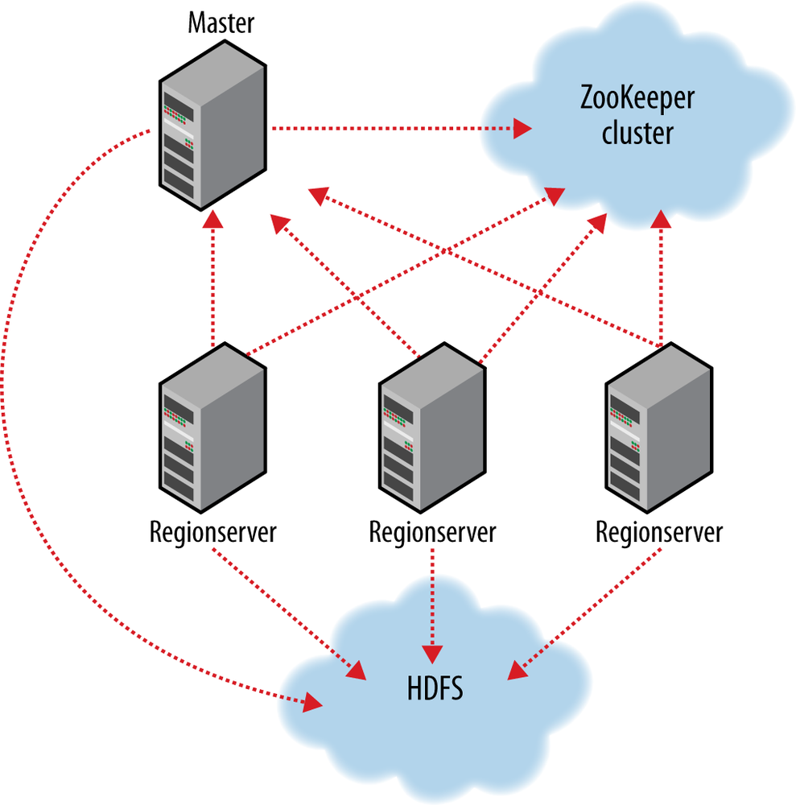
HBase Physical Architecture

Slide 50
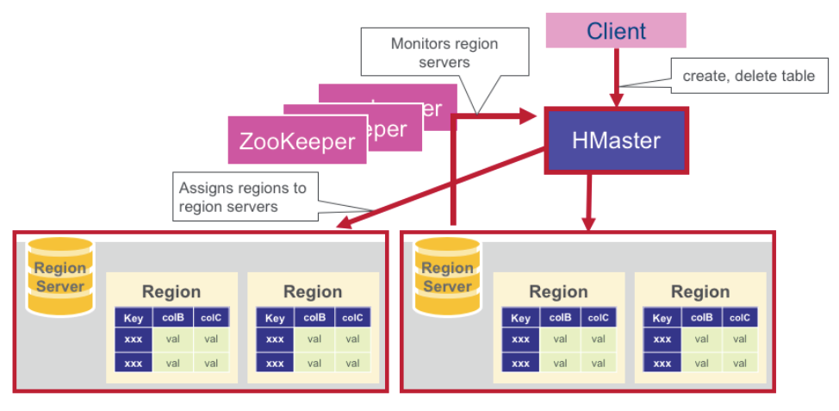
HBase HMaster

Slide 51
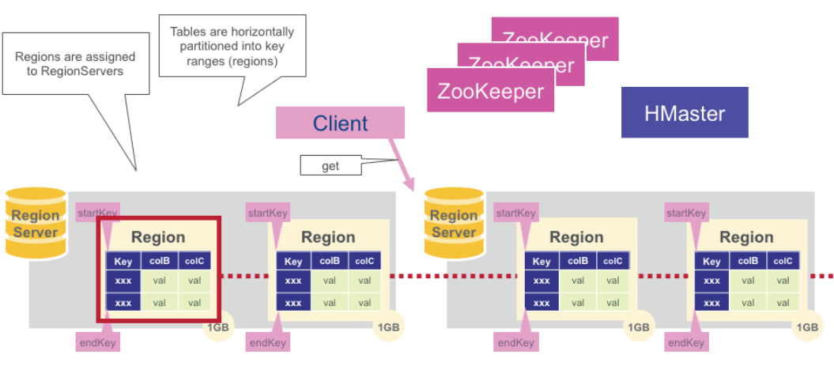
Regions

Slide 52
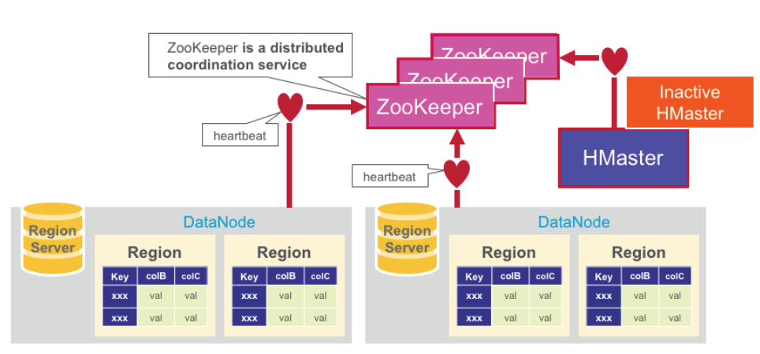
Zookeeper (Coordinator)

Slide 53
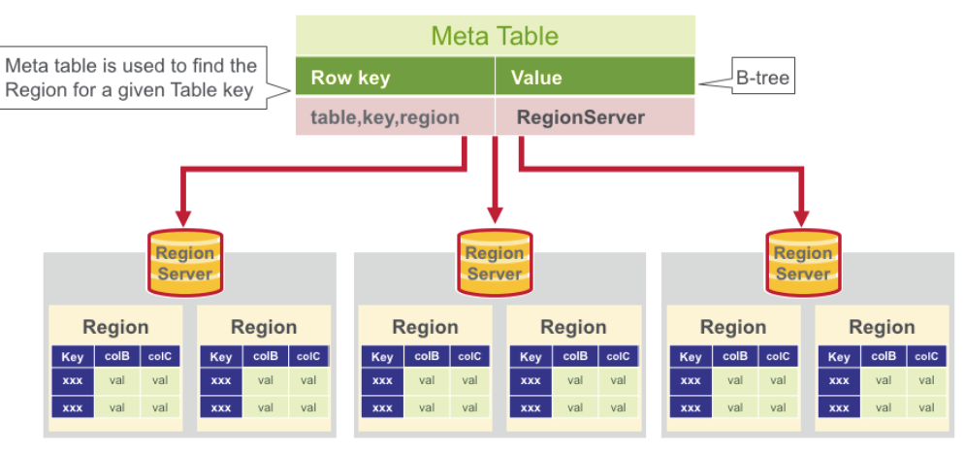
HBase Meta Table

Slide 54
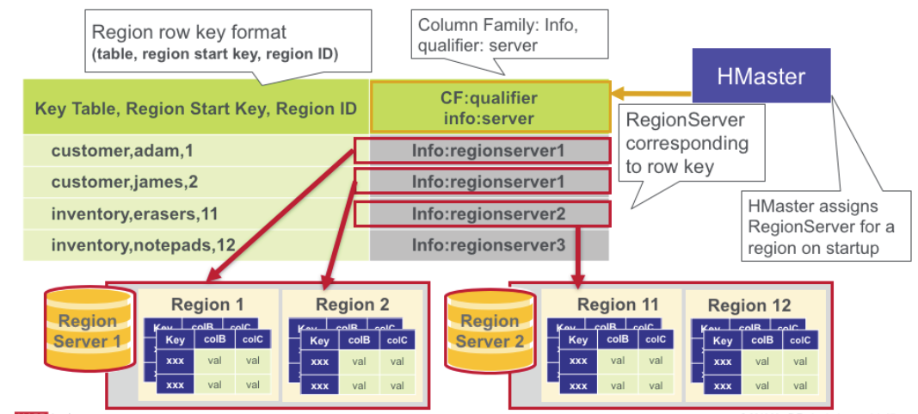
HBase Meta Table

